Slide 1

Chapter 12
Multiple Access
Copyright © The McGraw-Hill Companies, Inc. Permission required for reproduction or display.

Slide 2

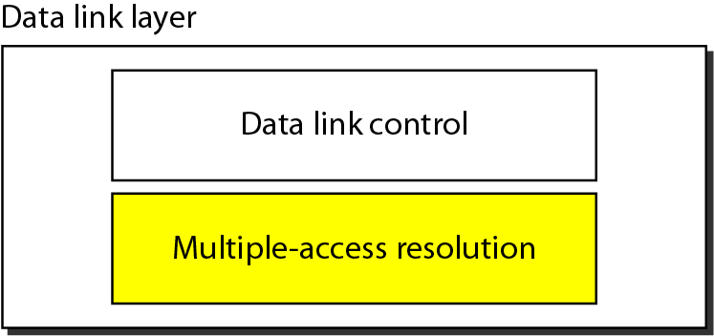

Figure 12.1 Data link layer divided into two functionality-oriented sublayers
Till now, we assumed that there is an available dedicated link (or channel) between the sender and the receiver.
A mechanism which provides a link with reliable communication.
responsible for resolving access to the shared media.

Slide 3
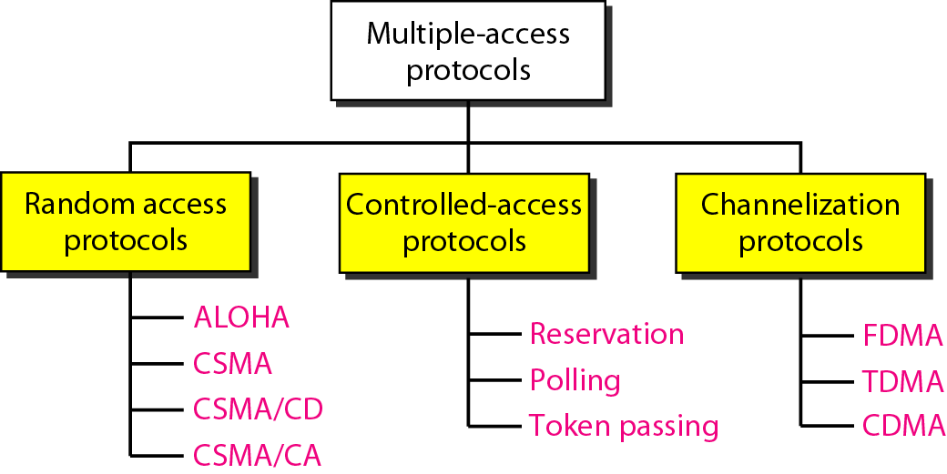
Figure 12.2 Taxonomy of multiple-access protocols discussed in this chapter

Slide 4
Figure 12.2 Taxonomy of multiple-access protocols discussed in this chapter
In random access or contention methods, no station is superior to another station and none is assigned the control over another.
In controlled access, the stations consult one another to find which station has the right to send. A station cannot send unless it has been authorized by other stations.
Channelization is a multiple-access method in which the available bandwidth of a link is shared in time, frequency, or through code, between different stations.

Slide 5
12-1 RANDOM ACCESS
In random access or contention methods, no station is superior to another station and none is assigned the control over another. No station permits, or does not permit, another station to send. At each instance, a station that has data to send uses a procedure defined by the protocol to make a decision on whether or not to send.
Topics discussed in this section:
ALOHA Carrier Sense Multiple Access
Carrier Sense Multiple Access with Collision Detection
Carrier Sense Multiple Access with Collision Avoidance

Slide 6
12-1 RANDOM ACCESS
Two features give this method its name.
First, there is no scheduled time for a station to transmit. Transmission is random among the stations. That is why these methods are called random access.
Second, no rules specify which station should send next. Stations compete with one another to access the medium. That is why these methods are also called contention methods.
Versions of ALOHA
Pure ALOHA
Slotted ALOHA

Slide 7
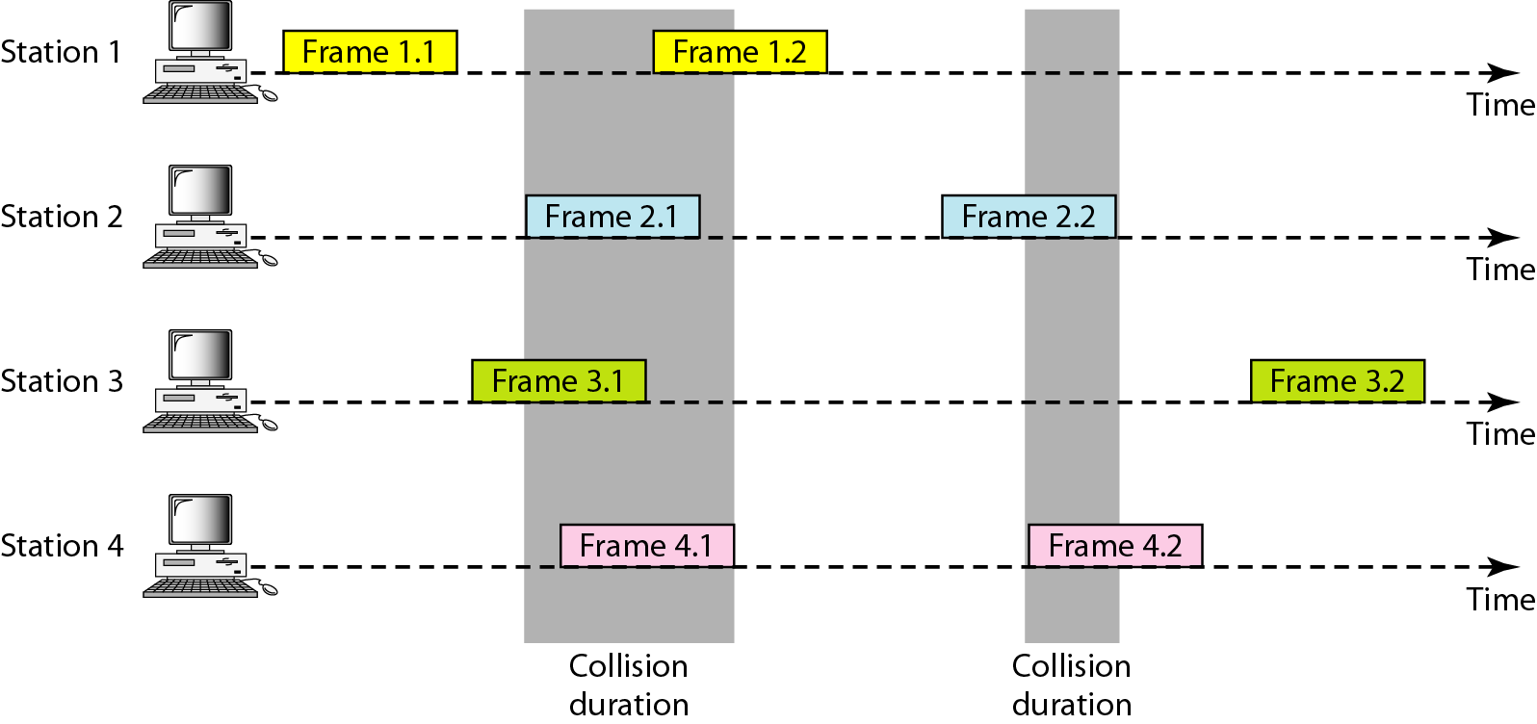
Figure 12.3 Frames in a pure ALOHA network
Even if one bit of a frame coexists on the channel with one bit from another frame, there is a collision and both will be destroyed.

Slide 8
Pure Aloha:
It allows the stations to transmit data at any time whenever they want.
After transmitting the data packet, station waits for some time.
Then, following 2 cases are possible-
Case-01:
Transmitting station receives an acknowledgement from the receiving station.
In this case, transmitting station assumes that the transmission is successful.
Case-02:
Transmitting station does not receive any acknowledgement within specified time from the receiving station.
In this case, transmitting station assumes that the transmission is unsuccessful.
Then,
Transmitting station uses a Back Off Strategy and waits for some random amount of time. (This is what reduces the collision)
After back off time, it transmits the data packet again.
It keeps trying until the back off limit is reached after which it aborts the transmission.

Slide 9
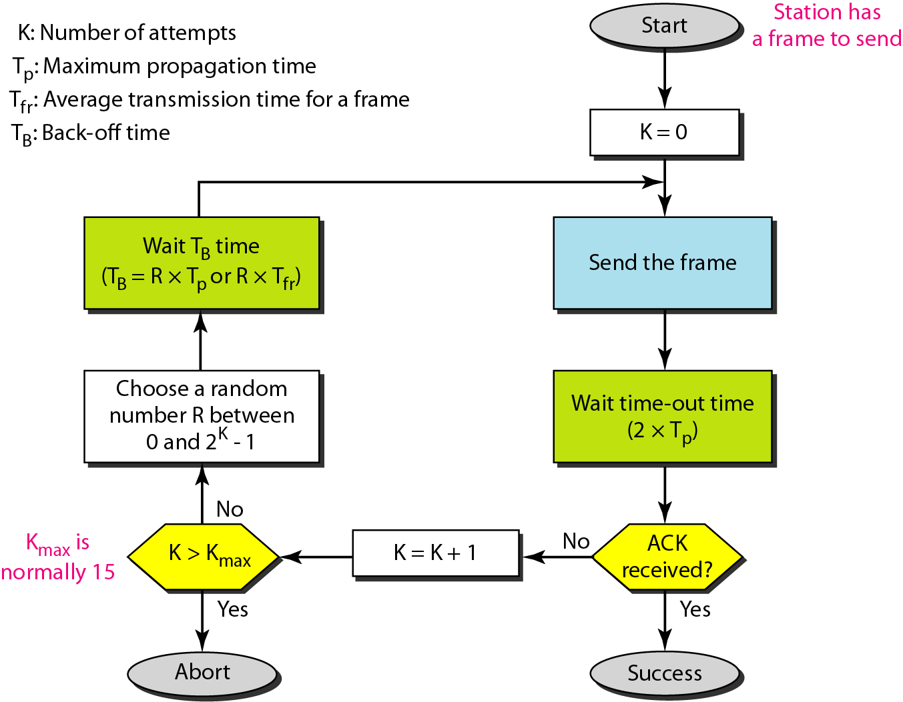
Figure 12.4 Procedure for pure ALOHA protocol

Slide 10
Example 12.1
The stations on a wireless ALOHA network are a maximum of 600 km apart. If we assume that signals propagate at 3 × 10⁸ m/s, we find
Tp = (600 × 10⁵ ) / (3 × 10⁸ ) = 2 ms.
Now we can find the value of T_{B} for different values of K .
a. For K = 1, the range is {0, 1}. The station needs to| generate a random number with a value of 0 or 1. This means that T_{B} is either 0 ms (0 × 2) or 2 ms (1 × 2), based on the outcome of the random variable.

Slide 11
Example 12.1 (continued)
b. For K = 2, the range is {0, 1, 2, 3}. This means that T_{B} can be 0, 2, 4, or 6 ms, based on the outcome of the random variable.
c. For K = 3, the range is {0, 1, 2, 3, 4, 5, 6, 7}. This means that T_{B} can be 0, 2, 4, . . . , 14 ms, based on the outcome of the random variable.
d. We need to mention that if K > 10, it is normally set to 10.

Slide 12
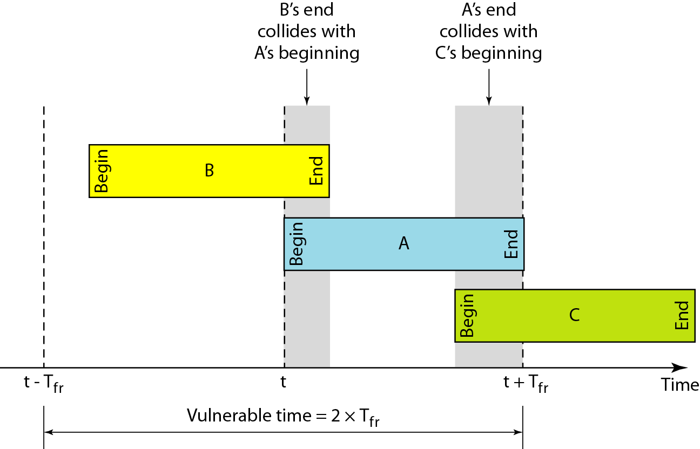
Figure 12.5 Vulnerable time for pure ALOHA protocol

Slide 13
Example 12.2
A pure ALOHA network transmits 200-bit frames on a shared channel of 200 kbps. What is the requirement to make this frame collision-free?
Solution
Average frame transmission time T_{fr} is 200 bits/200 kbps or 1 ms. The vulnerable time is 2 × 1 ms = 2 ms.
This means no station should send later than 1 ms before this station starts transmission and no station should start sending during the one 1-ms period that this station is sending.

Slide 14

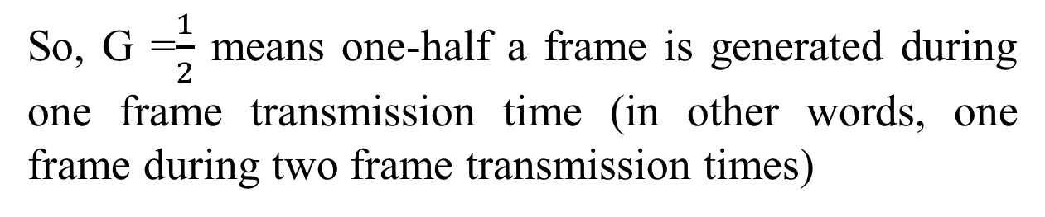
Note
The throughput for pure ALOHA is S = G × e ^{−2G} .
The maximum throughput
S_{max} = 0.184 when G= (1/2).
G=Number of Stations wish to transmit at the same time/
Number of frame generated during one frame transmission time

Slide 15
Example 12.3
A pure ALOHA network transmits 200-bit frames on a shared channel of 200 kbps. What is the throughput if the system (all stations together) produces
a. 1000 frames per second b. 500 frames per second
c. 250 frames per second.
Solution
The frame transmission time is 200/200 kbps or 1 ms.
a. If the system creates 1000 frames per second, this is 1 frame per millisecond. The load is 1. In this case S = G× e^{−2 G} or S = 0.135 (13.5 percent). This means that the throughput is 1000 × 0.135 = 135 frames. Only 135 frames out of 1000 will probably survive.

Slide 16
Example 12.3 (continued)
b. If the system creates 500 frames per second, this is (1/2) frame per millisecond. The load is (1/2). In this case S = G × e ^{−2G} or S = 0.184 (18.4 percent). This means that the throughput is 500 × 0.184 = 92 and that only 92 frames out of 500 will probably survive. Note that this is the maximum throughput case, percentagewise.
c. If the system creates 250 frames per second, this is (1/4) frame per millisecond. The load is (1/4). In this case S = G × e −^{2G} or S = 0.152 (15.2 percent). This means that the throughput is 250 × 0.152 = 38. Only 38 frames out of 250 will probably survive.

Slide 17
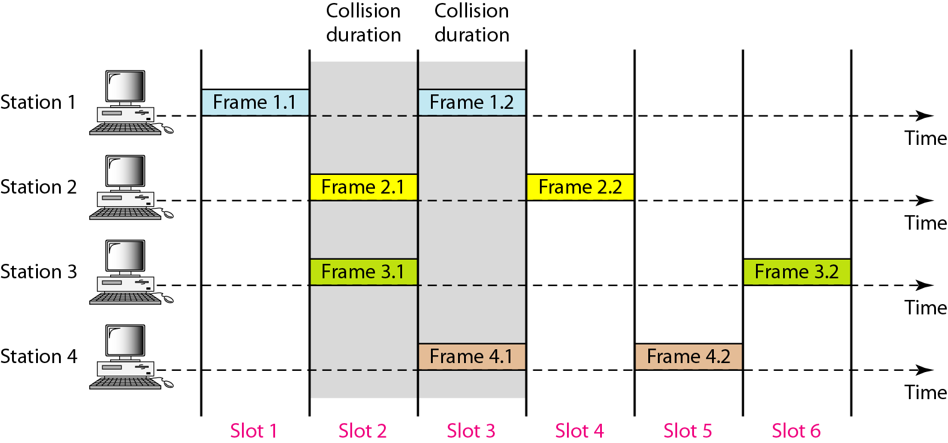
Figure 12.6 Frames in a slotted ALOHA network
In slotted ALOHA we divide the time into slots of Tfr s and force the station to send only at the beginning of the time slot.

Slide 18
Note
The throughput for slotted ALOHA is S = G × e^{−G} .
The maximum throughput S_{max} = 0.368 when G = 1.

Slide 19
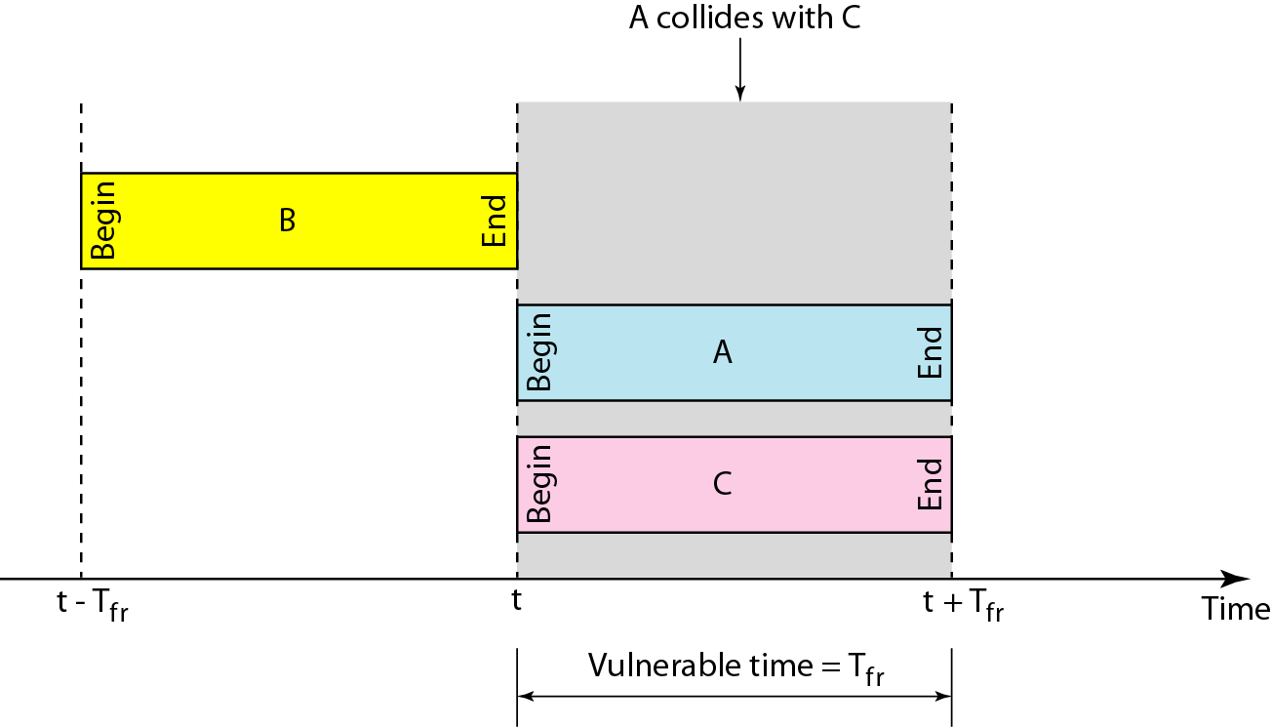
Figure 12.7 Vulnerable time for slotted ALOHA protocol

Slide 20
Example 12.4
A slotted ALOHA network transmits 200-bit frames on a shared channel of 200 kbps. What is the throughput if the system (all stations together) produces
a. 1000 frames per second b. 500 frames per second
c. 250 frames per second.
Solution
The frame transmission time is 200/200 kbps or 1 ms.
a. If the system creates 1000 frames per second, this is 1 frame per millisecond. The load is 1. In this case S = G× e^{−G} or S = 0.368 (36.8 percent). This means that the throughput is 1000 × 0.0368 = 368 frames. Only 386 frames out of 1000 will probably survive.

Slide 21
Example 12.4 (continued)
b. If the system creates 500 frames per second, this is (1/2) frame per millisecond. The load is (1/2). In this case S = G × e^{−G} or S = 0.303 (30.3 percent). This means that the throughput is 500 × 0.0303 = 151. Only 151 frames out of 500 will probably survive.
c. If the system creates 250 frames per second, this is (1/4) frame per millisecond. The load is (1/4). In this case S = G × e ^{−G} or S = 0.195 (19.5 percent). This means that the throughput is 250 × 0.195 = 49. Only 49 frames out of 250 will probably survive.

Slide 22
Carrier Sense Multiple Access (CSMA)
The chance of collision can be reduced if a station senses the medium before trying to use it.
Carrier sense multiple access (CSMA) requires that each station first listen to the medium (or check the state of the medium) before sending.
In other words, CSMA is based on the principle "sense before transmit" or "listen before talk."
Notes:
To minimize the chance of collision and, therefore, increase the performance, the CSMA method was developed.

Slide 23
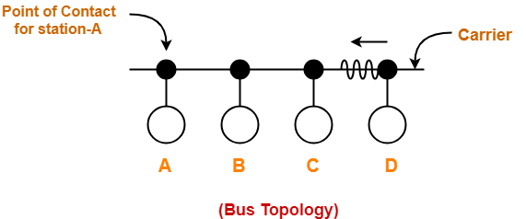
Carrier Sense Multiple Access (CSMA)
Sensing the Carrier:
Each station can sense the carrier only at its point of contact with the carrier.
It is not possible for any station to sense the entire carrier.
Thus, there is a huge possibility that a station might sense the carrier free even when it is actually not.
CSMA can reduce the possibility of collision, but it cannot eliminate it.
The possibility of collision still exists because of propagation delay.
Notes:
To minimize the chance of collision and, therefore, increase the performance, the CSMA method was developed.

Slide 24
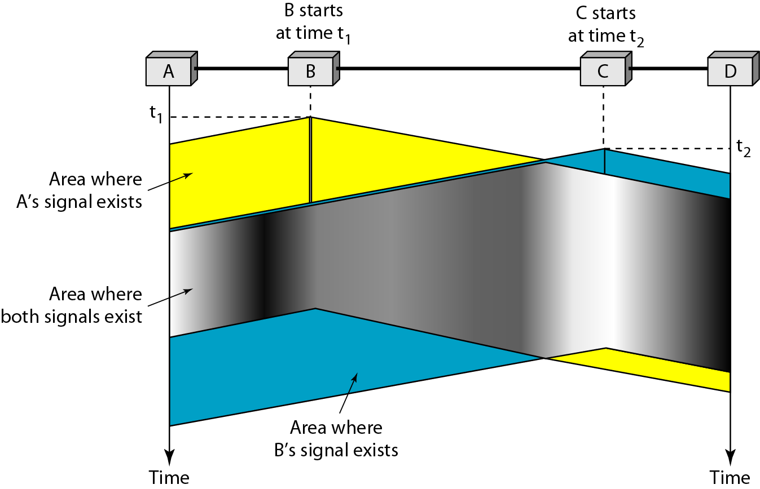
Figure 12.8 Space/time model of the collision in CSMA
Notes:
At time tI' station B senses the medium and finds it idle, so it sends a frame. At time
t2 (t2> t1)' station C senses the medium and finds it idle because, at this time, the first bits from station B have not reached station C. Station C also sends a frame. The two signals collide and both frames are destroyed.

Slide 25
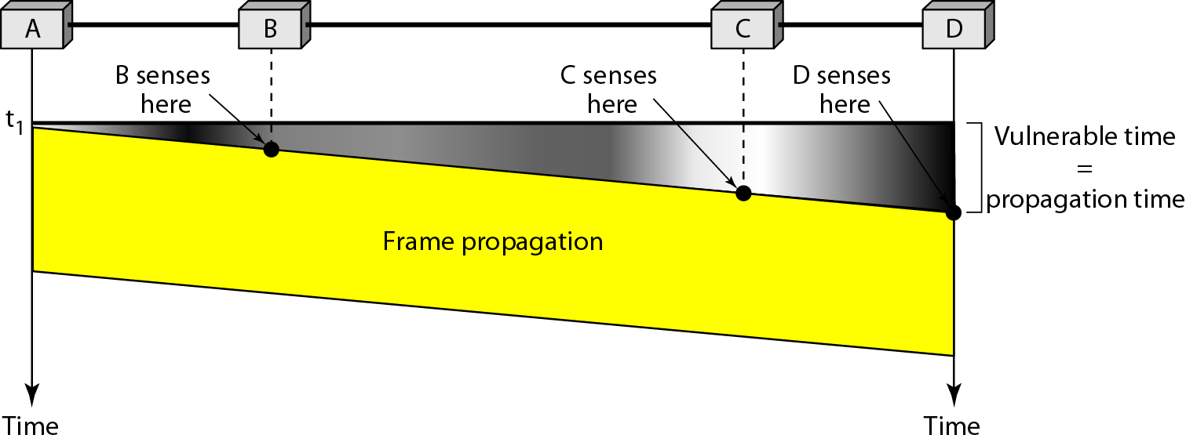
Figure 12.9 Vulnerable time in CSMA
The gray area shows the vulnerable area in time and space.

Slide 26
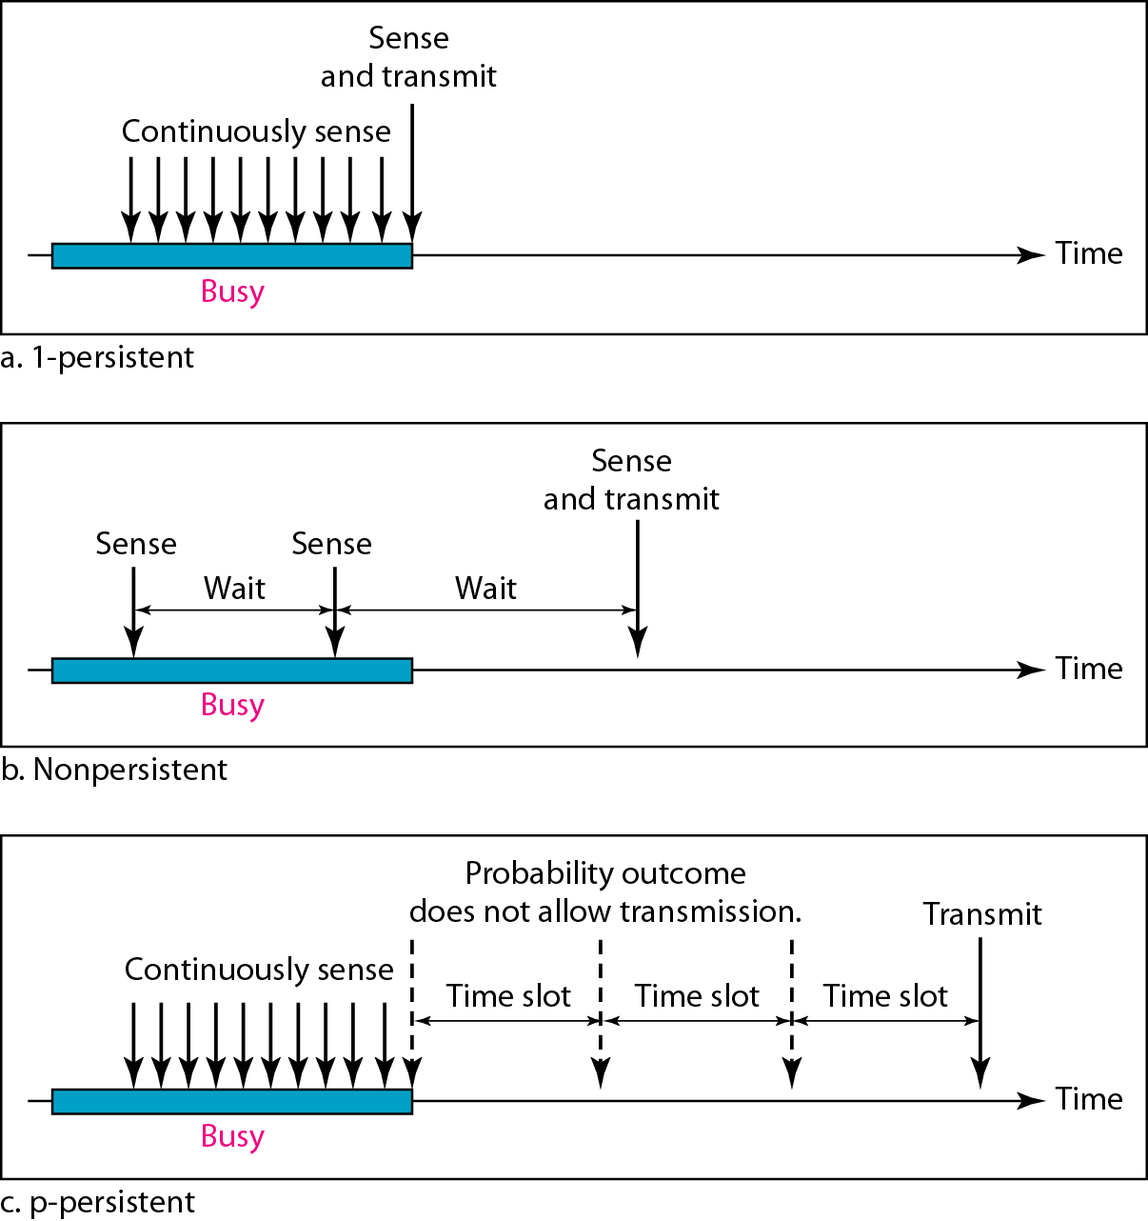
Figure 12.10 Behavior of three persistence methods
1-Persistent: The 1-persistent method is simple and straightforward. In this method, after the station finds the line idle, it sends its frame immediately (with probability 1). This method has the highest chance of collision because two or more stations may find the line idle and send their frames immediately. Ethernet uses this method.

Slide 27
Figure 12.10 Behavior of three persistence methods
Nonpersistent: In the nonpersistent method, a station that has a frame to send senses the line.
If the line is idle, it sends immediately.
If the line is not idle, it waits a random amount of time and then senses the line again.
The nonpersistent approach reduces the chance of collision because it is unlikely that two or more stations will wait the same amount of time and retry to send simultaneously.
However, this method reduces the efficiency of the network because the medium remains idle when there may be stations with frames to send.

Slide 28
Figure 12.10 Behavior of three persistence methods
p-Persistent: The p-persistent method is used if the channel has time slots with a slot duration equal to or greater than the maximum propagation time. The p-persistent approach combines the advantages of the other two strategies.
It reduces the chance of collision and improves efficiency. In this method, after the station finds the line idle it follows these steps:
With probability p, the station sends its frame.
With probability q = 1 - p, the station waits for the beginning of the next time slot and checks the line again.
a. If the line is idle, it goes to step 1.
b. If the line is busy, it acts as though a collision has occurred and uses the backoff procedure

Slide 29
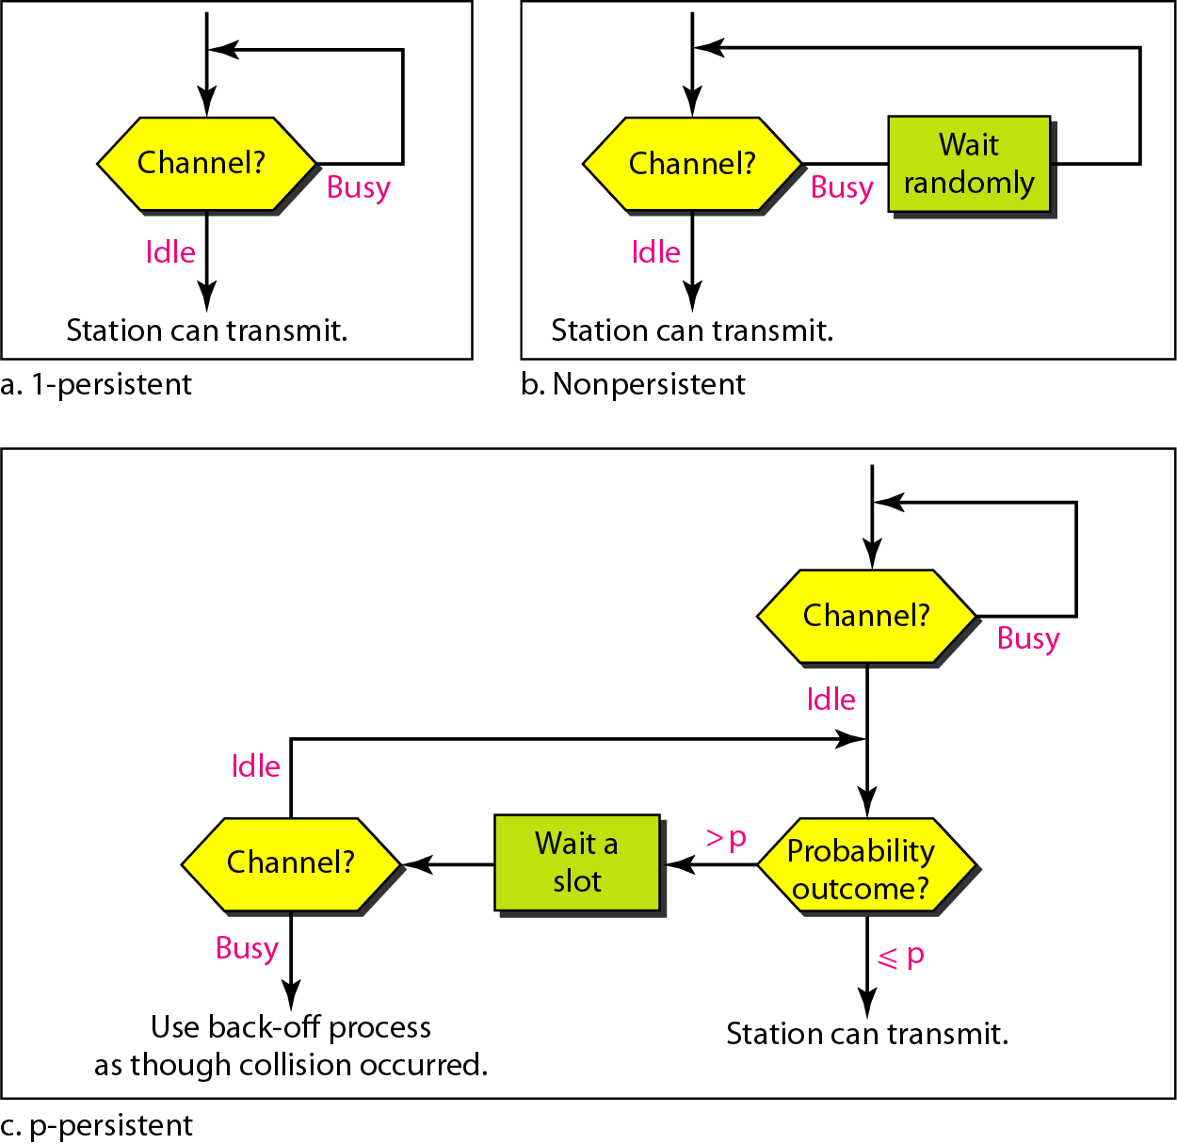
Figure 12.11 Flow diagram for three persistence methods

Slide 30
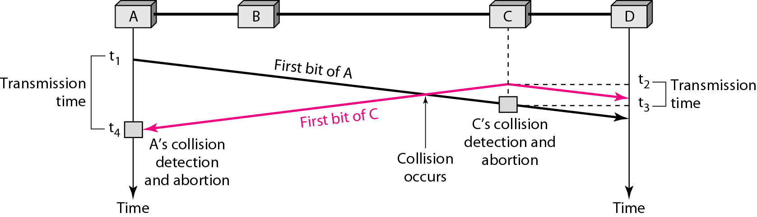
Figure 12.12 Collision of the first bit in CSMA/CD
In this method, a station monitors the medium after it sends a frame to see if the transmission was successful. If so, the station is finished.
If, however, there is a collision, the frame is sent again.
Stations A and C are involved in the collision

Slide 31
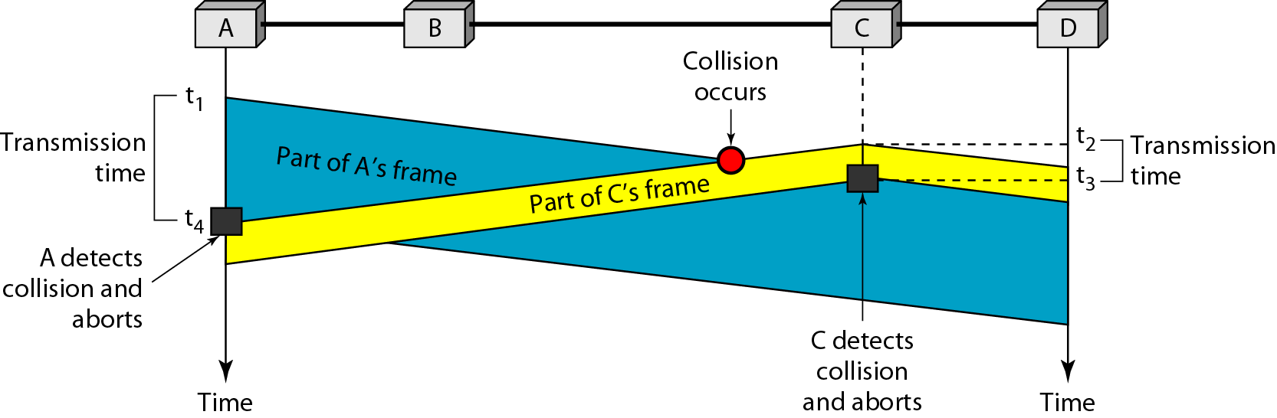
Figure 12.13 Collision and abortion in CSMA/CD
T_{fr} >= 2 × T_{p}
maximum propagation time,
T_{fr} = 2 × T_{p}
Notes:
https://www.geeksforgeeks.org/collision-detection-csmacd/

Slide 32
Example 12.5
A network using CSMA/CD has a bandwidth of 10 Mbps. If the maximum propagation time (including the delays in the devices and ignoring the time needed to send a jamming signal, as we see later) is 25.6 μs, what is the minimum size of the frame?
Solution
The frame transmission time is T_{fr} = 2 × T_{p} = 51.2 μs. This means, in the worst case, a station needs to transmit for a period of 51.2 μs to detect the collision. The minimum size of the frame is 10 Mbps × 51.2 μs = 512 bits or 64 bytes. This is actually the minimum size of the frame for Standard Ethernet.

Slide 33
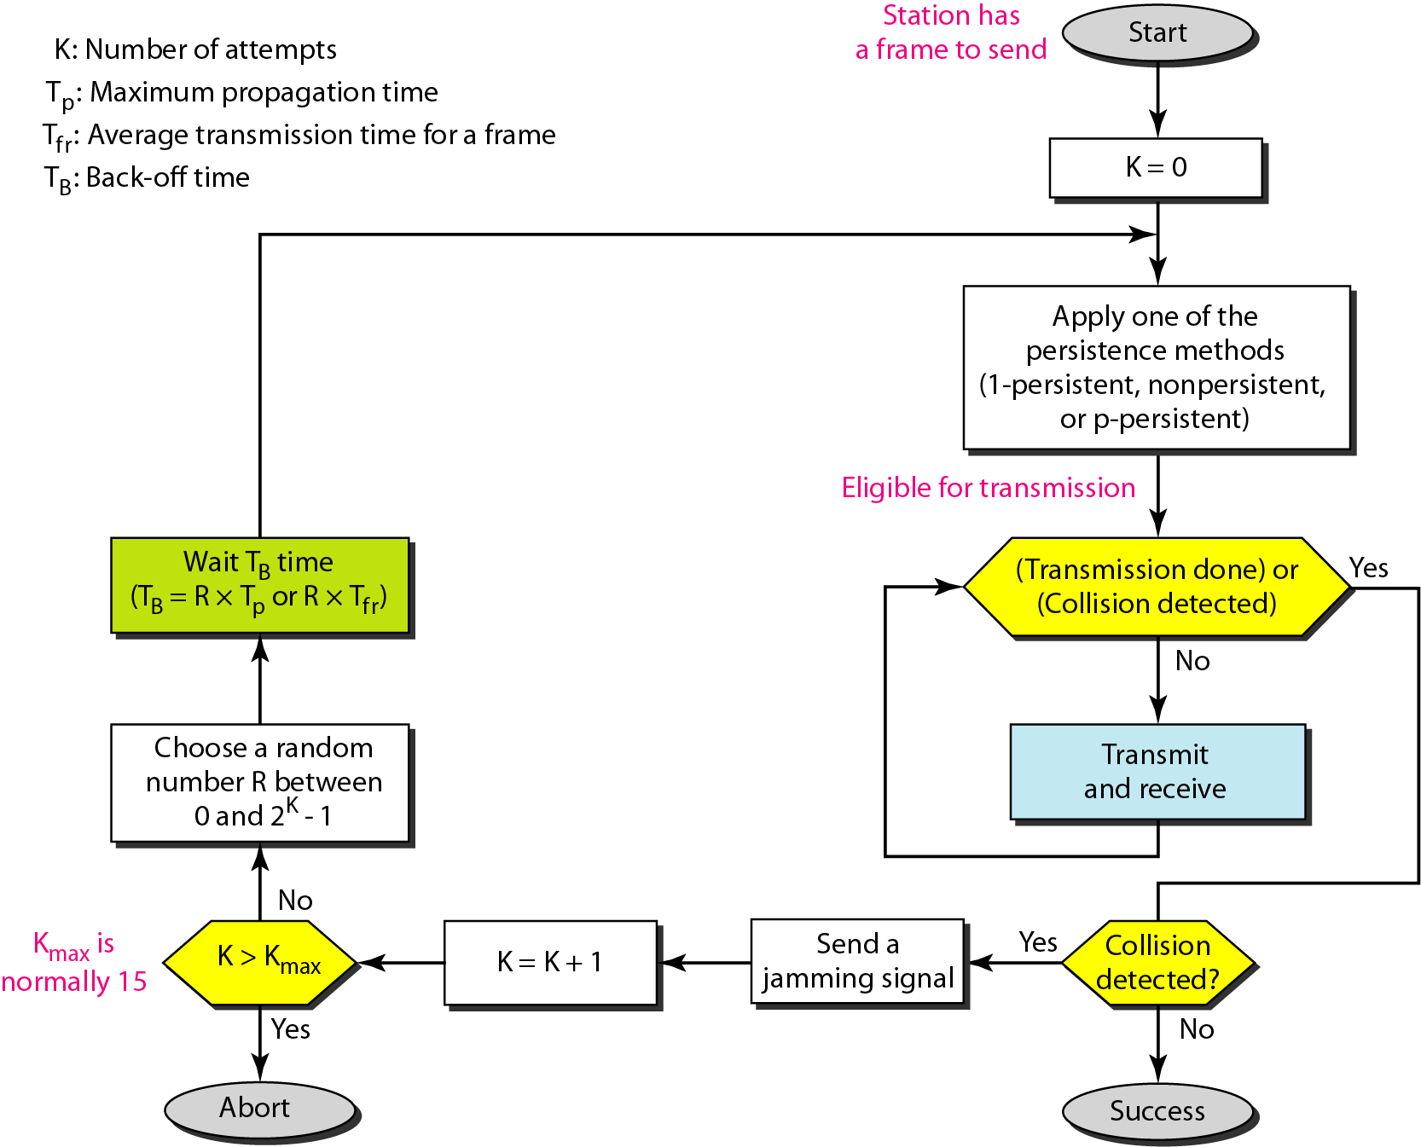
Figure 12.14 Flow diagram for the CSMA/CD

Slide 34
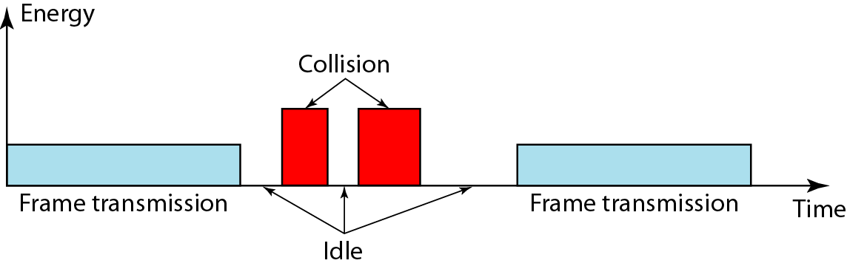
Figure 12.15 Energy level during transmission, idleness, or collision

Slide 35
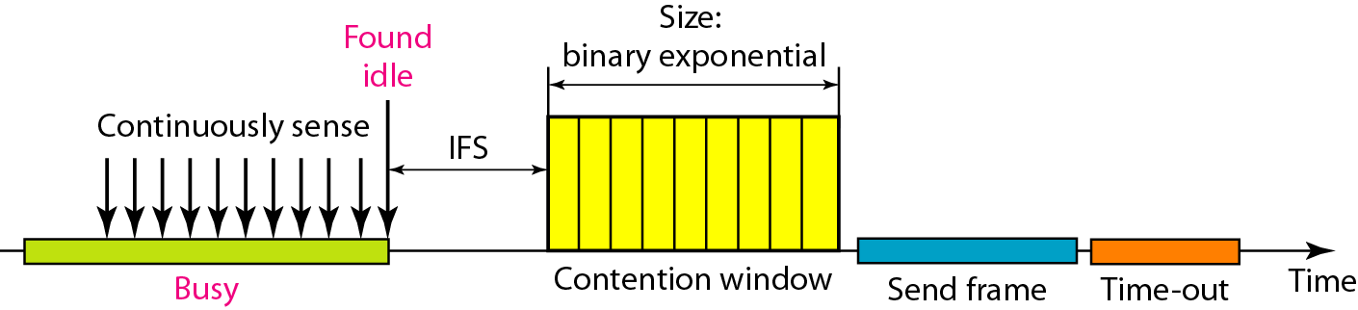
Figure 12.16 Timing in CSMA/CA
Collisions are avoided through the use of CSMA/CA's three strategies:
the interframe space (IFS)
the contention window and
acknowledgments

Slide 36
Note
In CSMA/CA, the IFS can also be used to define the priority of a station or a frame.

Slide 37
Note
In CSMA/CA, if the station finds the channel busy, it does not restart the timer of the contention window;
it stops the timer and restarts it when the channel becomes idle.

Slide 38
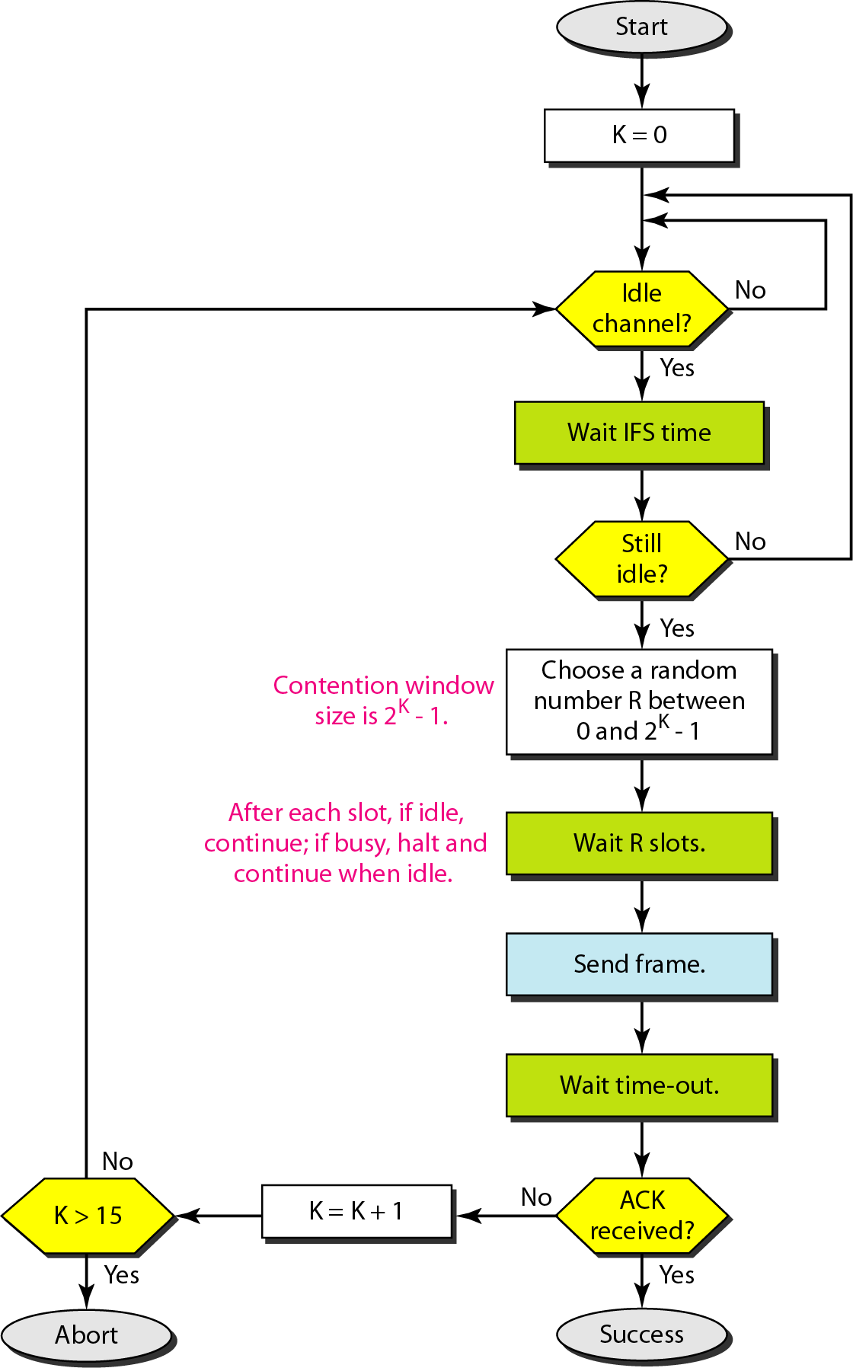
Figure 12.17 Flow diagram for CSMA/CA

Slide 39
12-2 CONTROLLED ACCESS
In controlled access, the stations consult one another to find which station has the right to send. A station cannot send unless it has been authorized by other stations. We discuss three popular controlled-access methods.
Topics discussed in this section:
Reservation Polling Token Passing

Slide 40
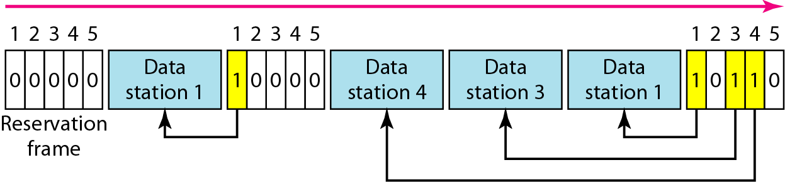
Figure 12.18 Reservation access method
Reservation
In the reservation method, a station needs to make a reservation before sending data.
Time is divided into intervals. In each interval, a reservation frame precedes the data frames sent in that interval.

Slide 41
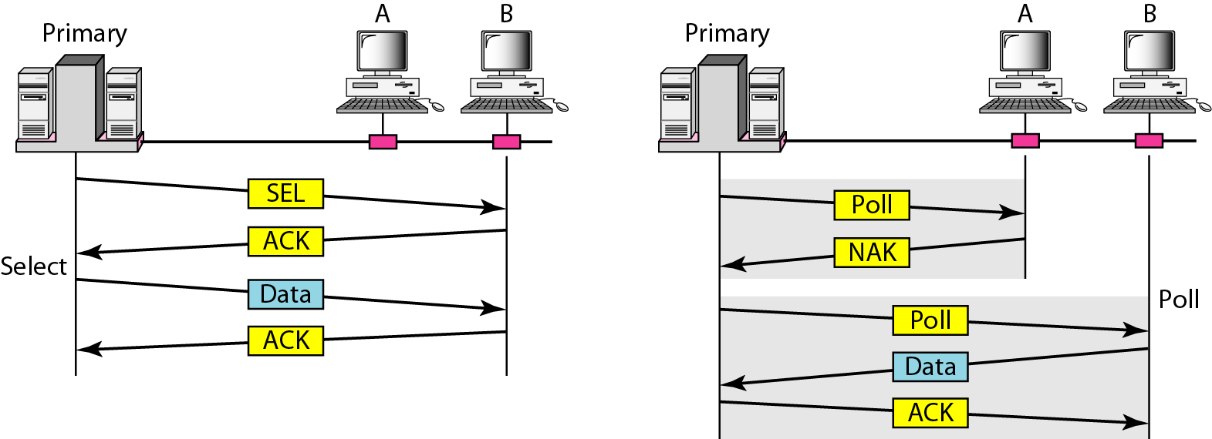
Figure 12.19 Select and poll functions in polling access method

Slide 42
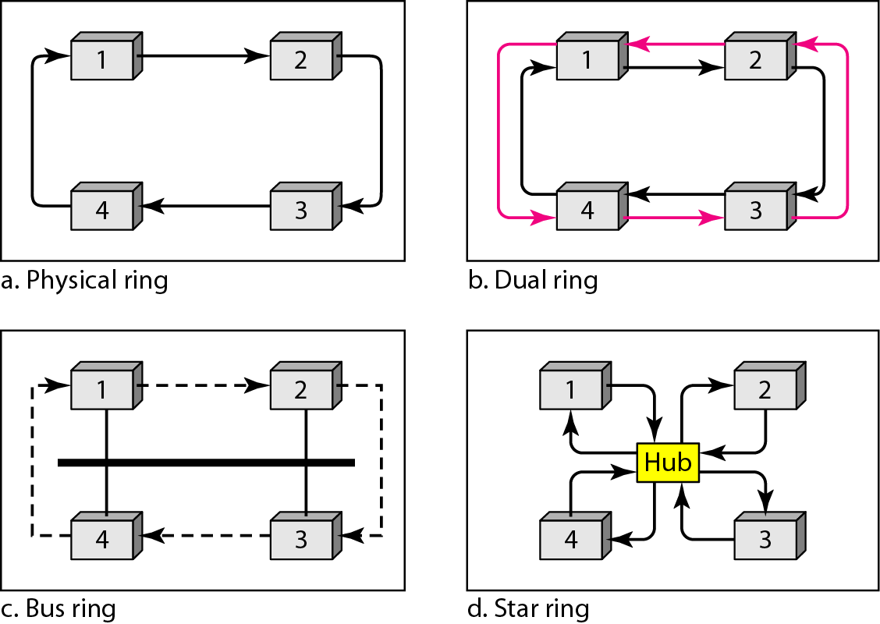
Figure 12.20 Logical ring and physical topology in token-passing access method

Slide 43
12-3 CHANNELIZATION
Channelization is a multiple-access method in which the available bandwidth of a link is shared in time, frequency, or through code, between different stations. In this section, we discuss three channelization protocols.
Topics discussed in this section:
Frequency-Division Multiple Access (FDMA) Time-Division Multiple Access (TDMA)
Code-Division Multiple Access (CDMA)

Slide 44
Note
We see the application of all these methods in Chapter 16 when we discuss cellular phone systems.

Slide 45
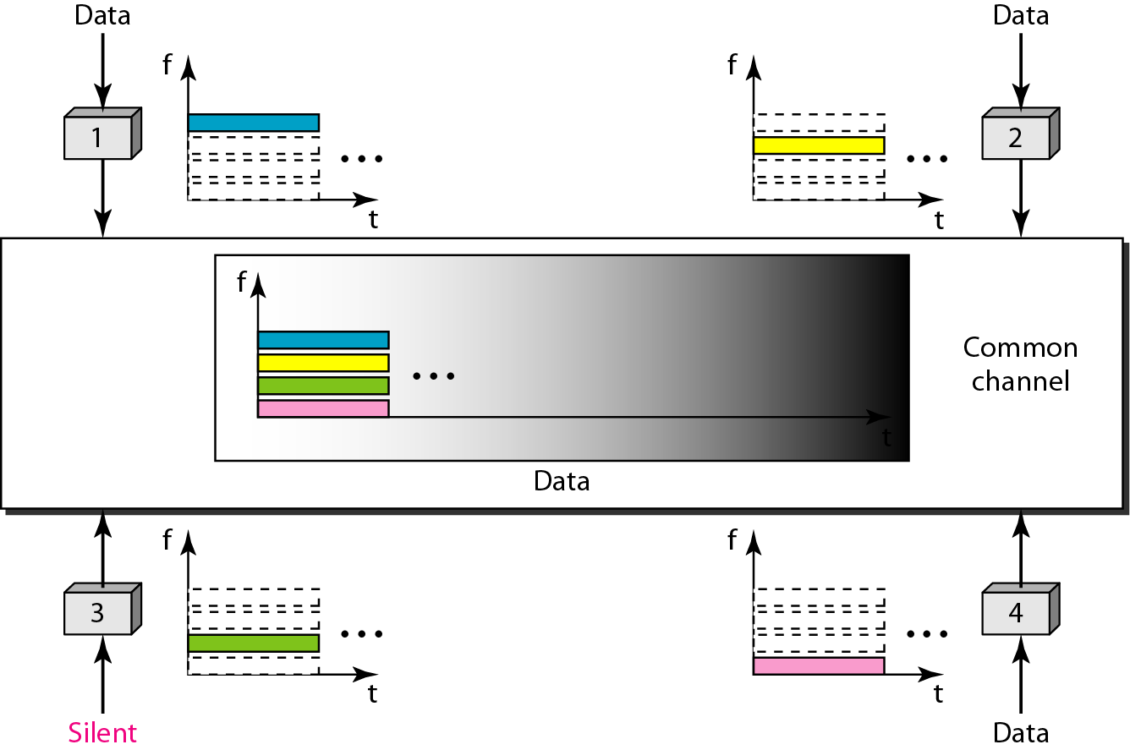
Figure 12.21 Frequency-division multiple access (FDMA)

Slide 46
Note
In FDMA, the available bandwidth of the common channel is divided into bands that are separated by guard bands.

Slide 47
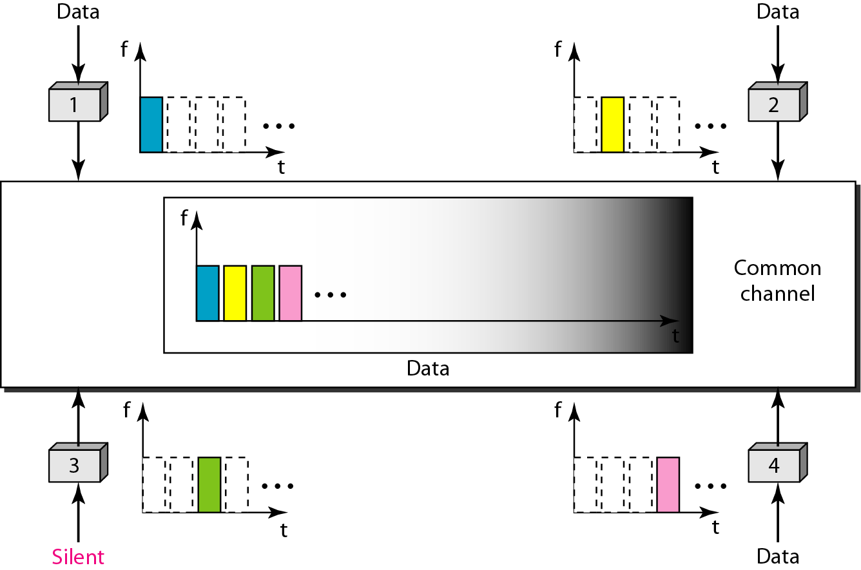
Figure 12.22 Time-division multiple access (TDMA)

Slide 48
Note
In TDMA, the bandwidth is just one channel that is timeshared between different stations.

Slide 49
Note
In CDMA, one channel carries all transmissions simultaneously.

Slide 50
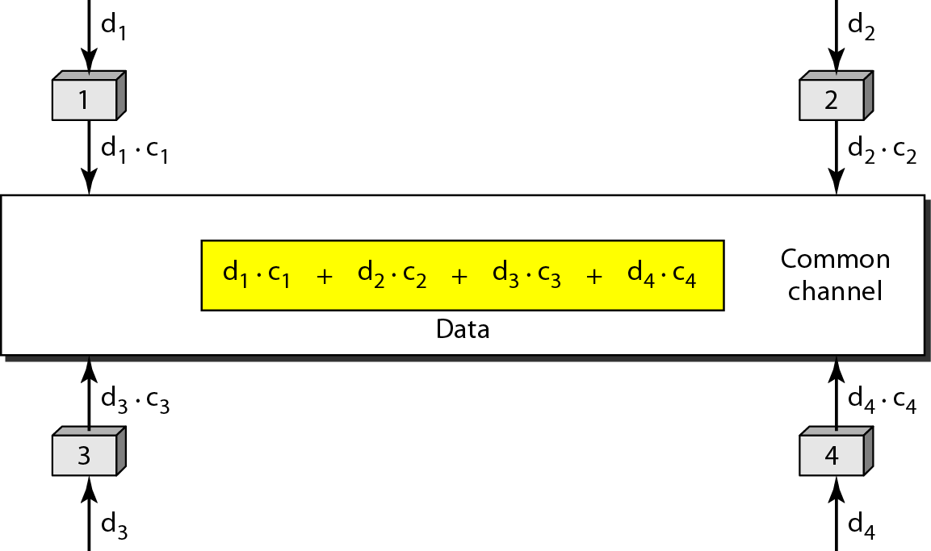
Figure 12.23 Simple idea of communication with code

Slide 51
Figure 12.24 Chip sequences

Slide 52
Figure 12.25 Data representation in CDMA
Data Representation

Slide 53
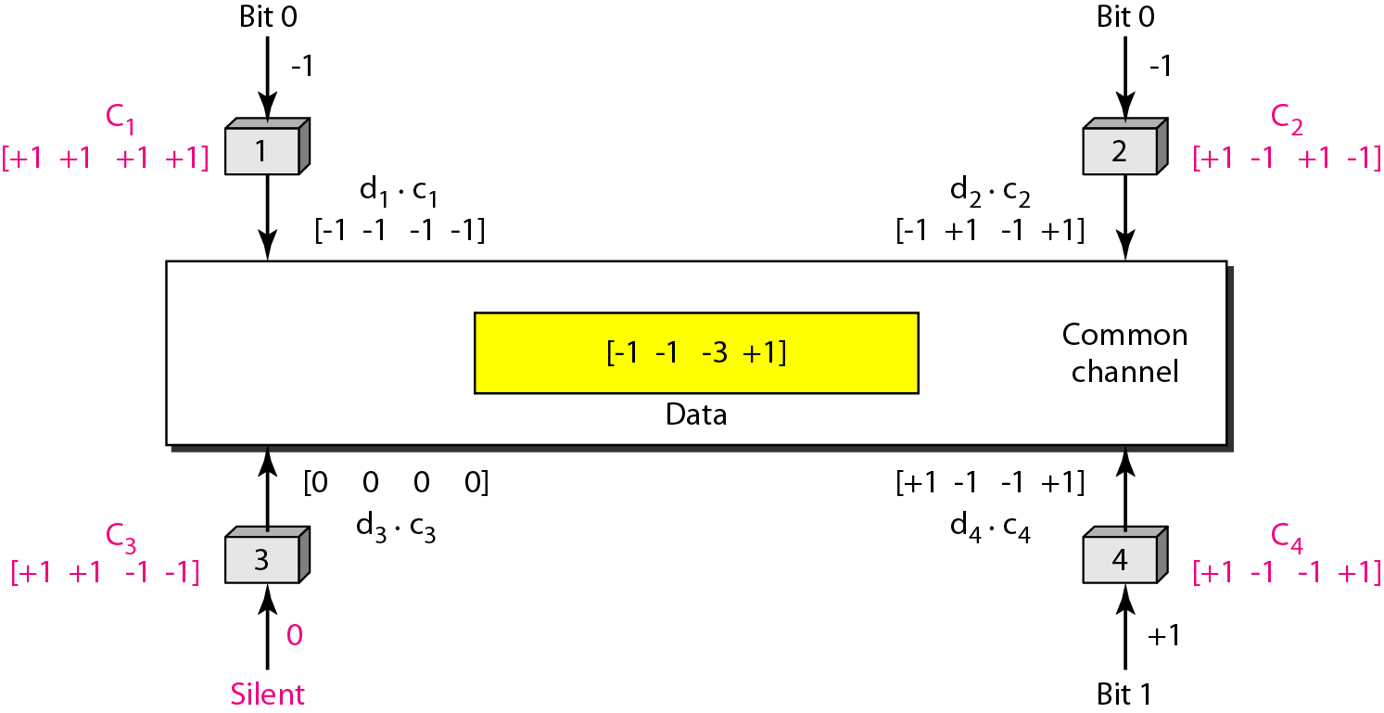
Figure 12.26 Sharing channel in CDMA

Slide 54
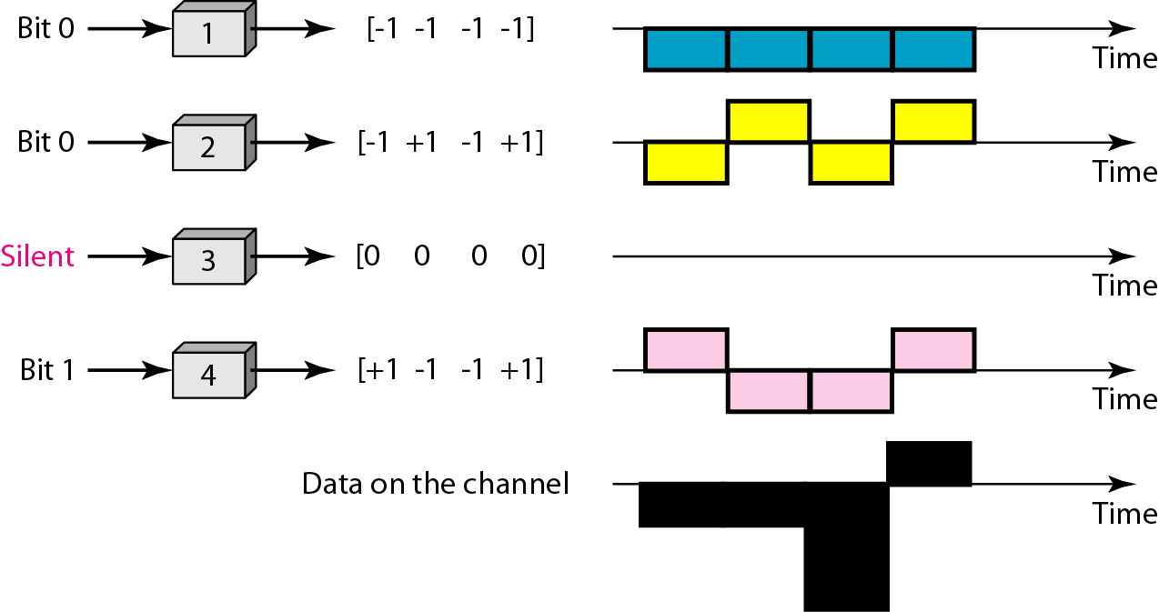
Figure 12.27 Digital signal created by four stations in CDMA

Slide 55
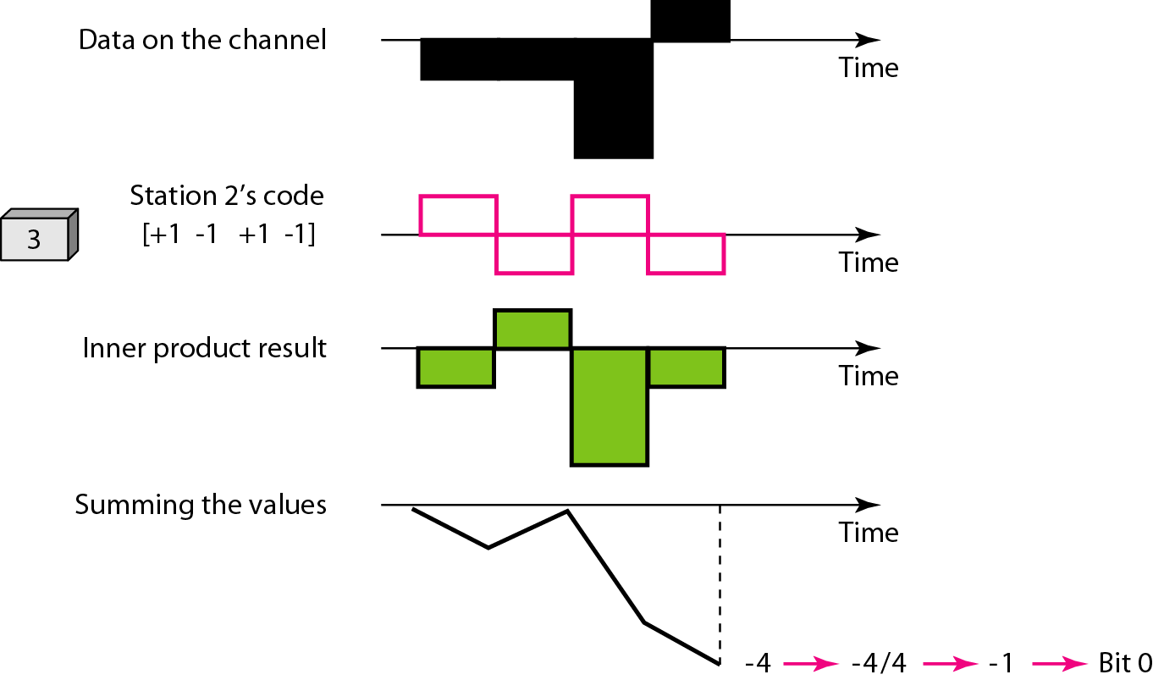
Figure 12.28 Decoding of the composite signal for one in CDMA

Slide 56
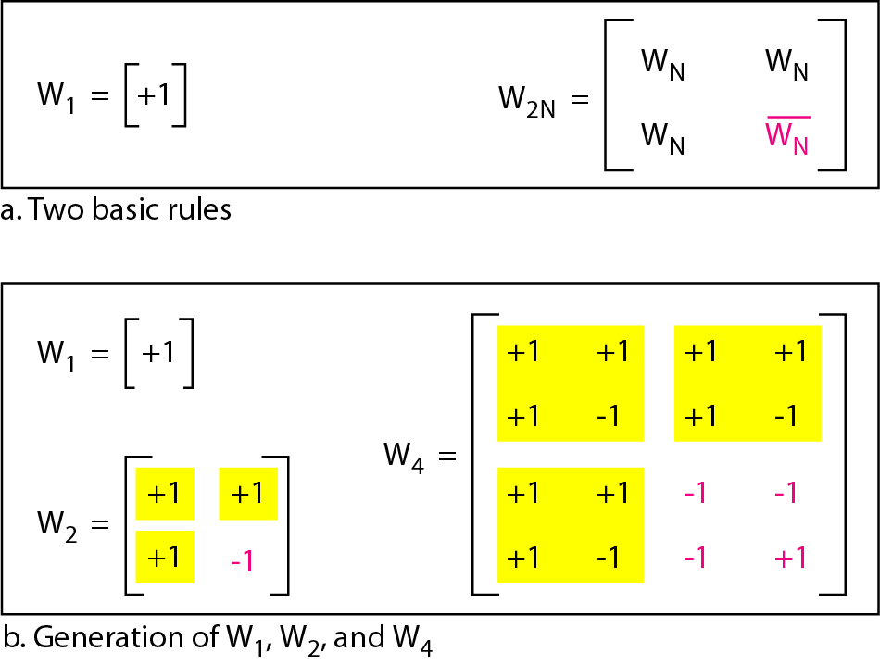
Figure 12.29 General rule and examples of creating Walsh tables

Slide 57
Note
The number of sequences in a Walsh table needs to be N = 2^{m}.

Slide 58
Example 12.6
Find the chips for a network with
a. Two stations b. Four stations
Solution
We can use the rows of W2 and W4 in Figure 12.29:
a. For a two-station network, we have [+1 +1] and [+1 −1].
b. For a four-station network we have [+1 +1 +1 +1], [+1 −1 +1 −1], [+1 +1 −1 −1], and [+1 −1 −1 +1].

Slide 59
Example 12.7
What is the number of sequences if we have 90 stations in our network?
Solution
The number of sequences needs to be 2^{m}. We need to choose m = 7 and N = 2⁷ or 128. We can then use 90 of the sequences as the chips.

Slide 60
Example 12.8
Prove that a receiving station can get the data sent by a specific sender if it multiplies the entire data on the channel by the sender’s chip code and then divides it by the number of stations.
Solution
Let us prove this for the first station, using our previous four-station example. We can say that the data on the channel D = (d1 ⋅ c1 + d2 ⋅ c2 + d3 ⋅ c3 + d4 ⋅ c4). The receiver which wants to get the data sent by station 1 multiplies these data by c1.

Slide 61
Example 12.8 (continued)
When we divide the result by N, we get d1 .

